Slide 1
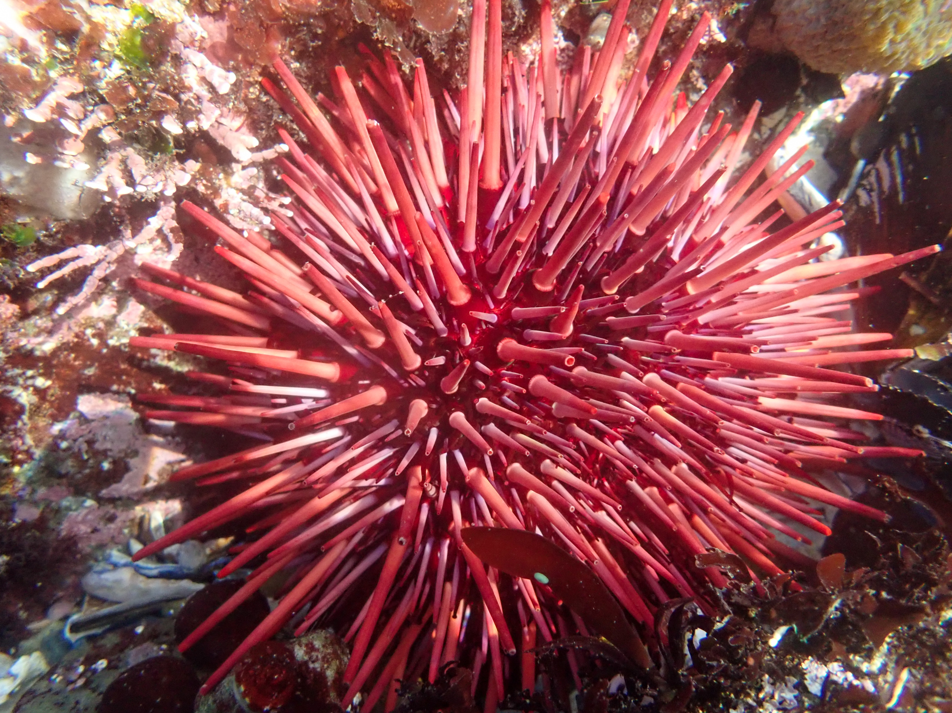
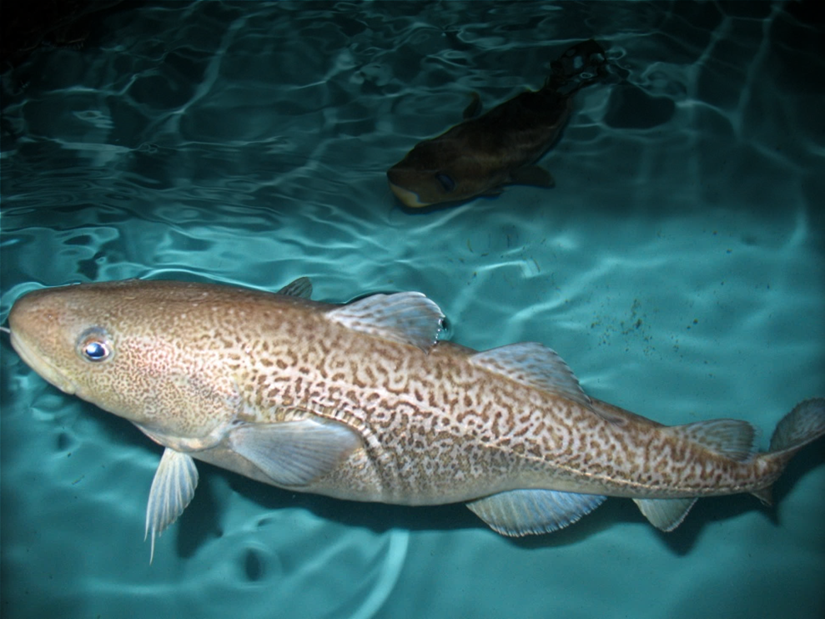
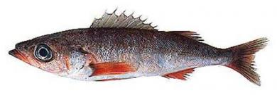
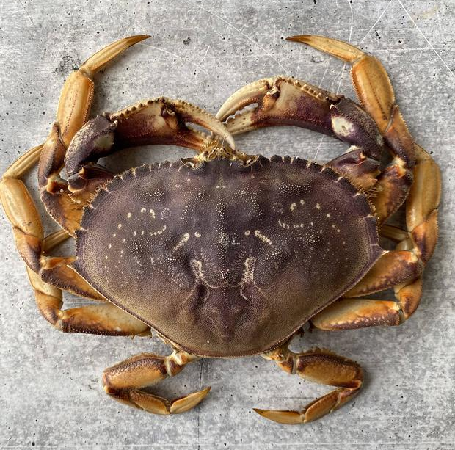
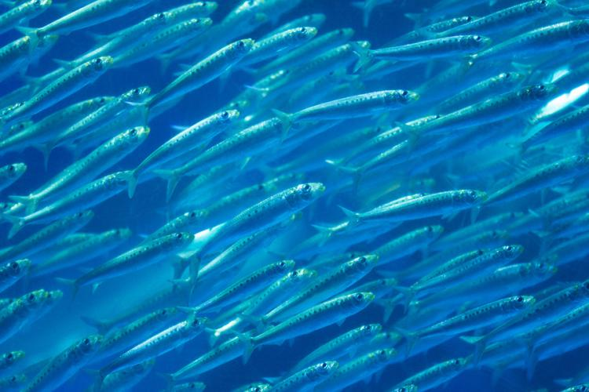
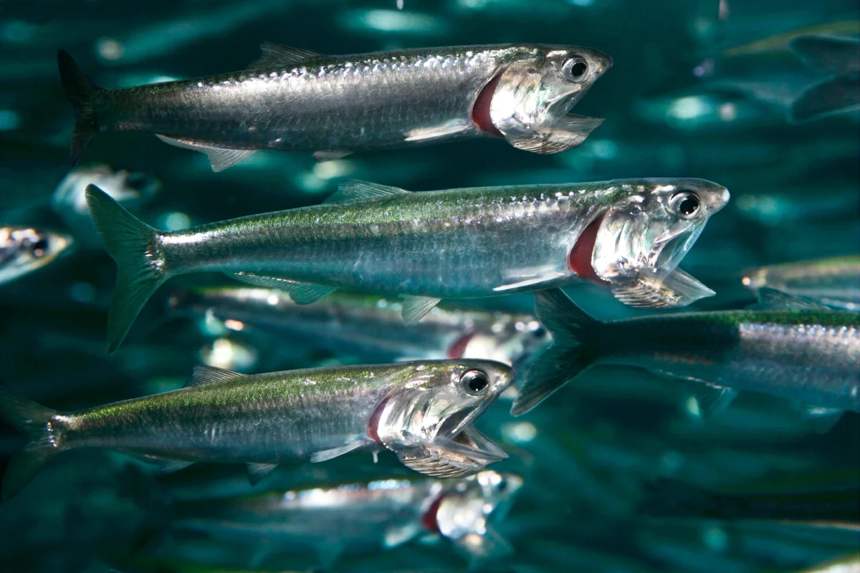
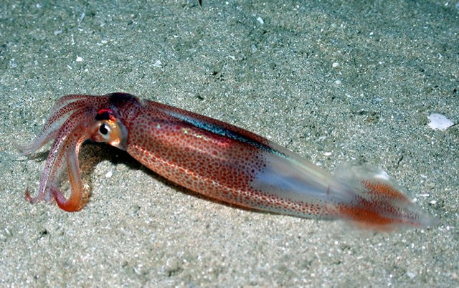
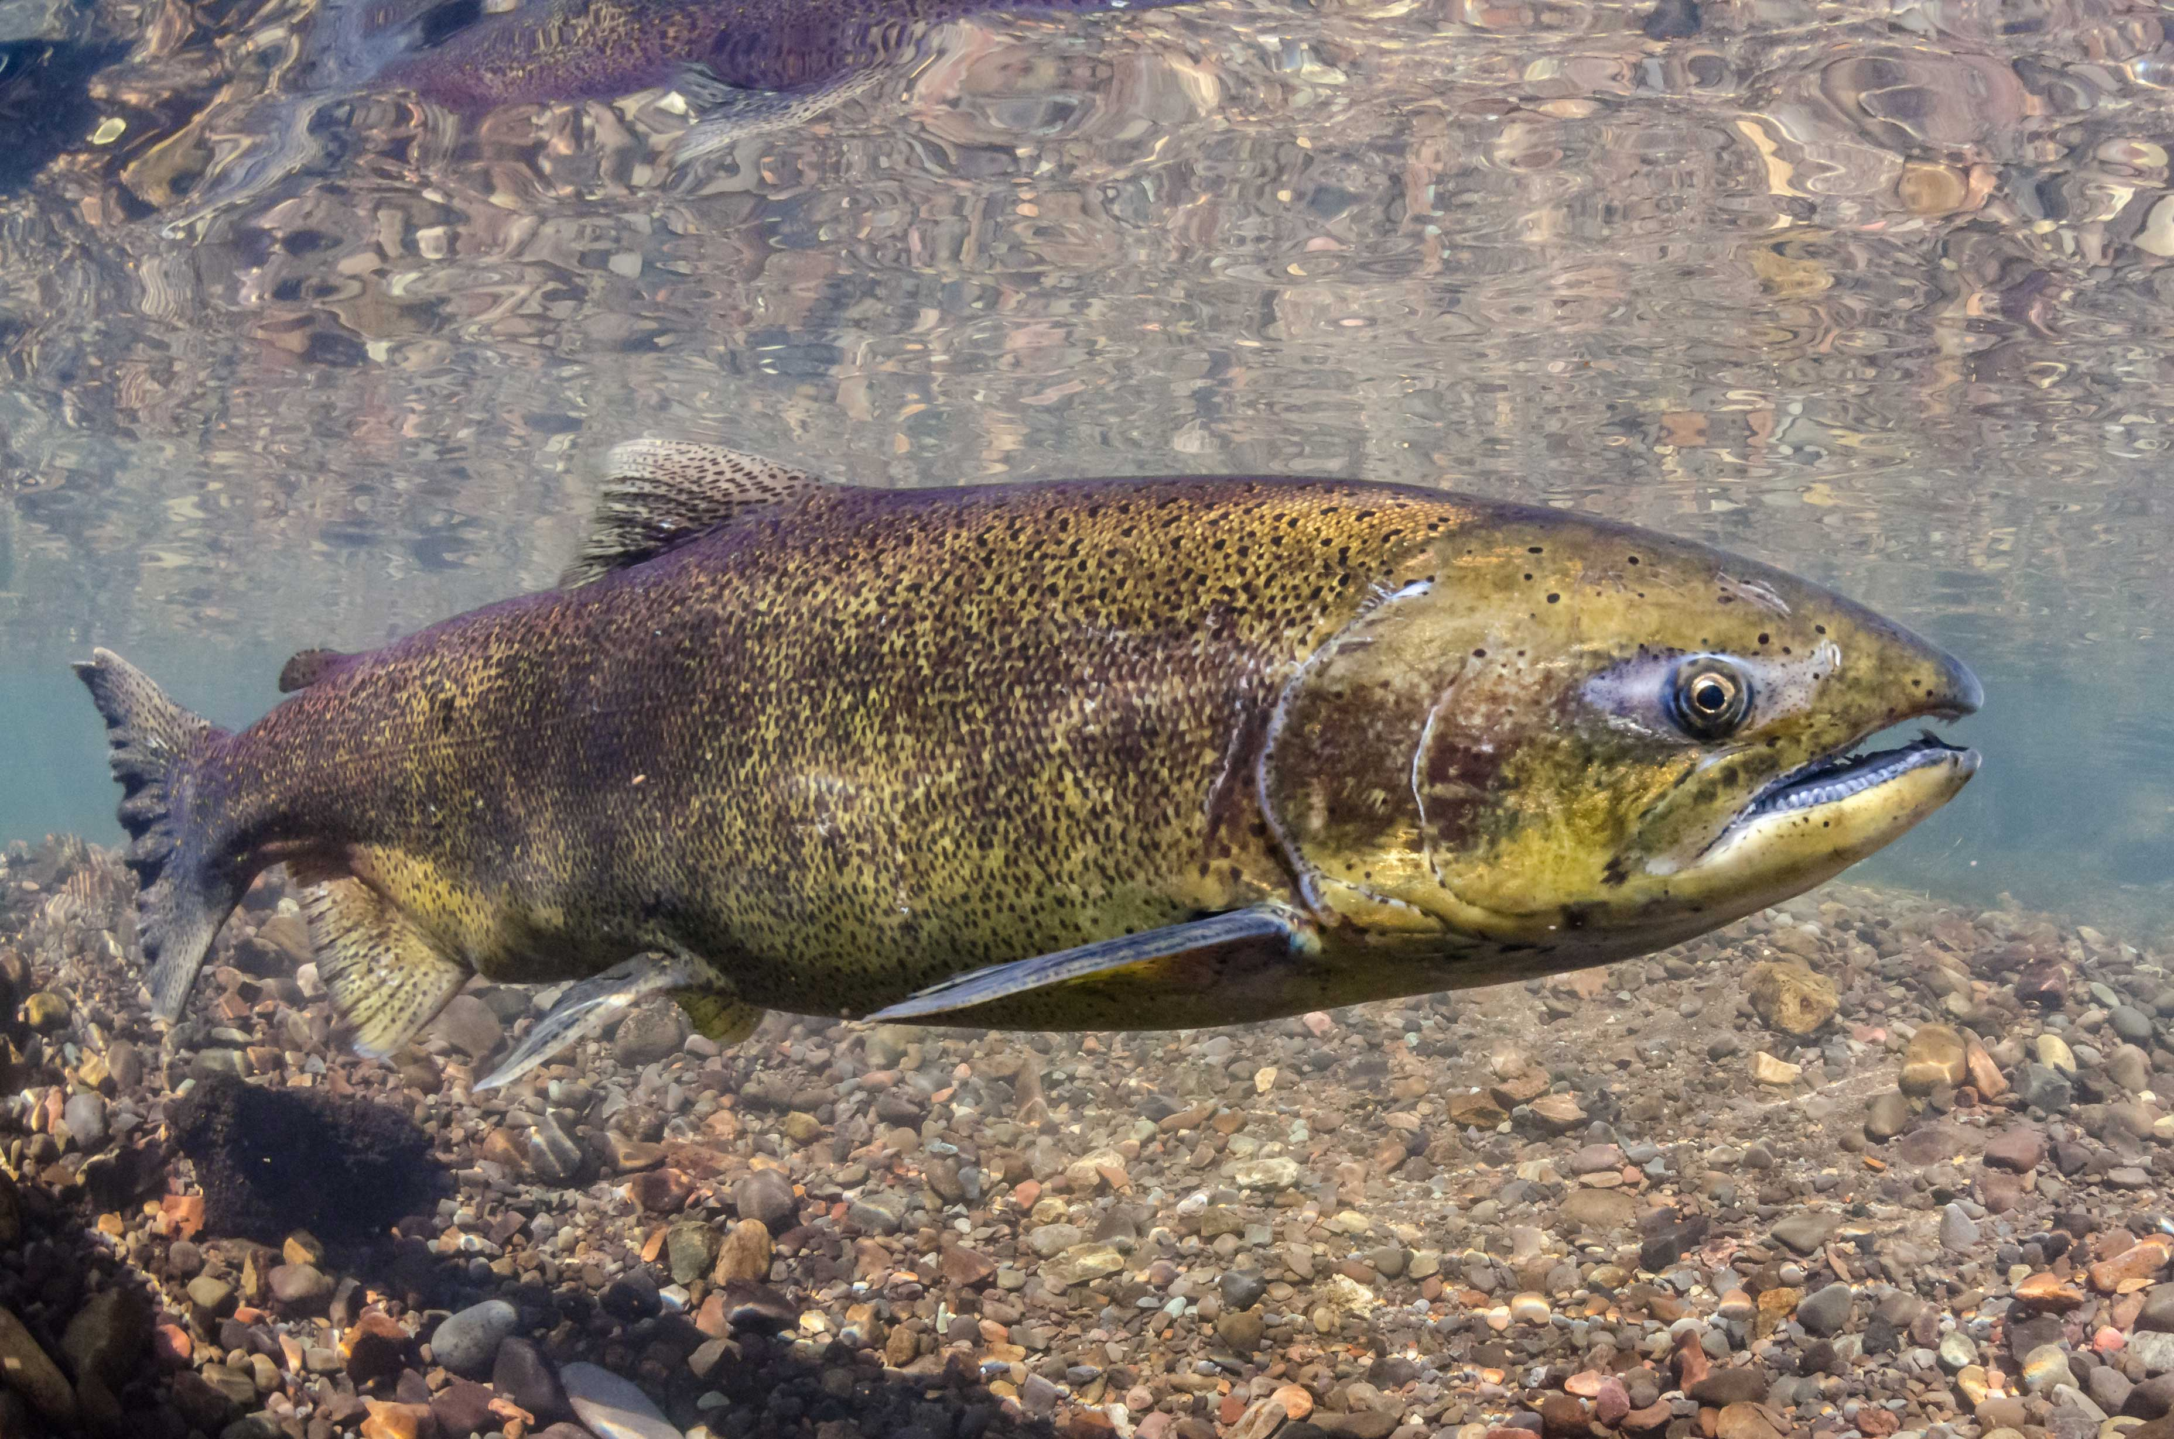
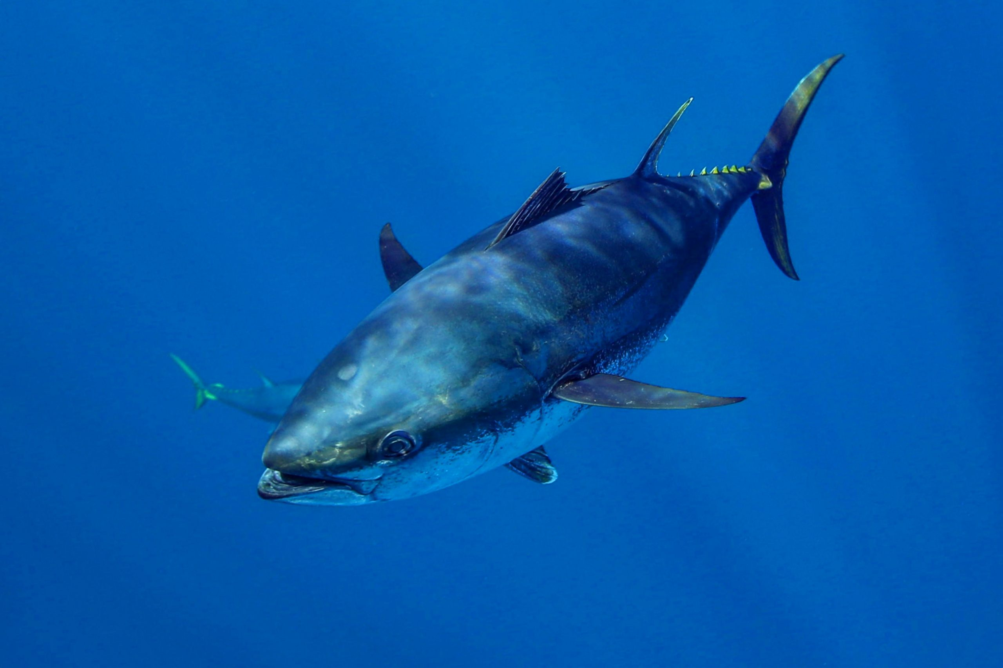
Urchin/abalone
Population declines due to loss of kelp beds.
Another positive one
Find another positive one with an interesting story to tell right here.
?
Pacific cod
Population declines due to reduced prey and increased metabolic demands.
Shrimp
Major heatwave and climate change winner – but don’t know why yet
Dungeness crab
Fishery closures due HABs and whale entanglements.
Shortbelly rockfish
Increases in abundance approached bycatch limits in Pacific hake fishery.
Sardine/anchovy
Sardines low while anchovies high; surprise!
Market squid
Increases in distribution leads to unregulated emerging fishery.
Chinook salmon
Overfished due to reduced productivity and model failure.
Bluefin tuna
Increased abundance was a boon for the recreational fishing industry.
Direct negative impacts
Indirect negative impacts
Neutral
impacts
Positive impacts, w/ higher mgmt. challenges
Positive impacts, w/ lower mgmt. challenges
Ecological impact of the heatwave

